Slide 1
Unit 5
Solving & Graphing Linear Inequalities
Algebra 1

Slide 2


Key Words
OPEN CIRCLE
$$<or>$$
CLOSED CIRCLE
$$≤or≥$$
Graph the Way the Arrow Points

Slide 3
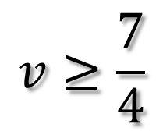

GRAPH THE INEQUALITY
$$v≥\frac{7}{4}$$
$$x<−3$$

Slide 4
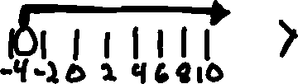


Write the Inequality for the Graph

Slide 5
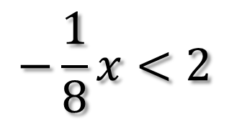
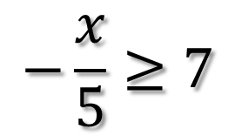


Solving Inequalities
$$−\frac{x}{5}≥7$$
$$−\frac{1}{8}x<2$$
Solving Inequalities is the Same as Solving Equations
If you MULTIPLY OR DIVIDE by a NEGATIVE NUMBER, you MUST FLIP THE INEQUALITY
$$−4x≤20$$
$$−7x≻21$$

Slide 6
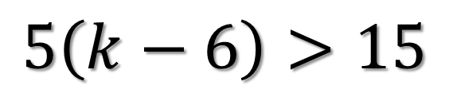
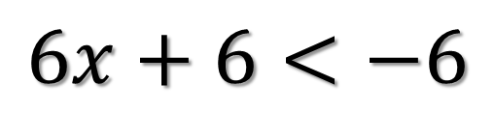
$$6x+6<−6$$
Solving Inequalities
Solving Inequalities is the Same as Solving Equations
If you MULTIPLY OR DIVIDE by a NEGATIVE NUMBER, you MUST FLIP THE INEQUALITY
$$5\left(k−6\right)>15$$

Slide 7
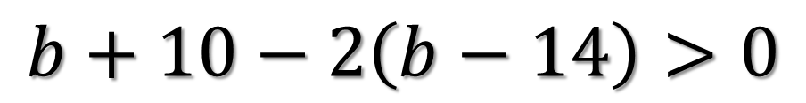

$$w+6−2\left(w−14\right)>0$$
Solving Inequalities
Solving Inequalities is the Same as Solving Equations
If you MULTIPLY OR DIVIDE by a NEGATIVE NUMBER, you MUST FLIP THE INEQUALITY
$$b+10−2\left(b−14\right)>0$$

Slide 8
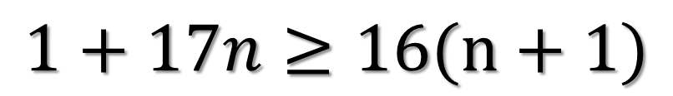
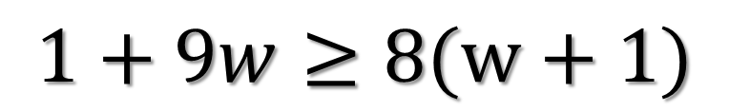
$$1+9w≥8(w+1)$$
Solving Inequalities
Solving Inequalities is the Same as Solving Equations
If you MULTIPLY OR DIVIDE by a NEGATIVE NUMBER, you MUST FLIP THE INEQUALITY
$$1+17n≥16(n+1)$$

Slide 9
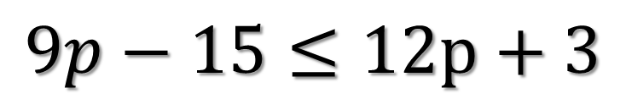
$$9p−15≤12p+3$$
Solving Inequalities
Solving Inequalities is the Same as Solving Equations
If you MULTIPLY OR DIVIDE by a NEGATIVE NUMBER, you MUST FLIP THE INEQUALITY

Slide 10
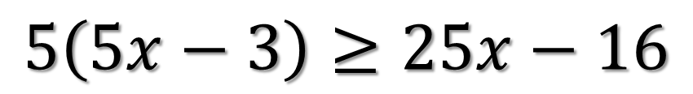
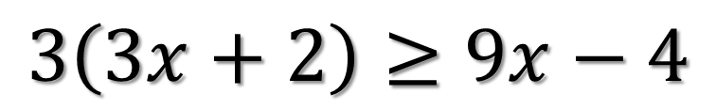
$$3\left(3x+2\right)≥9x−4$$
Solving Inequalities
If the variables cancel out, you will be left with either a true or false statement.
If TRUE: The solution is ALL REAL NUMBERS
If FALSE: NO SOLUTION
$$5\left(5x−3\right)≥25x−16$$

Slide 11
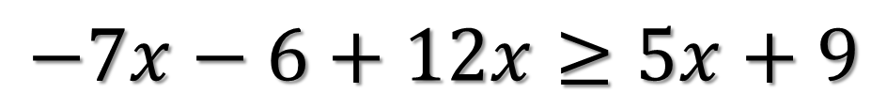
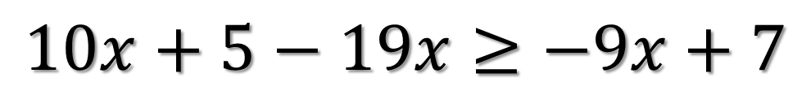
$$10x+5−19x≥−9x+7$$
Solving Inequalities
If the variables cancel out, you will be left with either a true or false statement.
If TRUE: The solution is ALL REAL NUMBERS
If FALSE: NO SOLUTION
$$−7x−6+12x≥5x+9$$

